Slide 1


1
PROJECT PRESENTATION
SCHOOL OF ELECTRICAL AND MECHANICAL
DEPARTMENT OF ELECTRICAL,COMPUTER AND TELECOMMUNICATIONS
Multi-Agent Deep Reinforcement Learning for Adaptive Traffic Signal Control in the Palapye A1 Corridor
TSOTLHE NAYANG SEIPHEPI
21001137
EEEN 520 Final Year Project
Supervisor: Dr Bokamoso Basutli
Date: 20/05/26
Notes:
WERE

Slide 2
2
OUTLINE
INTRODUCTION
PROBLEM STATEMENT
AIM & OBJECTIVES
LITERATURE REVIEW
METHODOLOGY
SYSTEM PERFORMANCE TESTING
RESULTS – PHASE 2 (MAPPO)
RESULTS ANALYSIS & COMPARISON
DISCUSSION & ASSUMPTIONS
CONCLUSION
REFERENCES

Slide 3
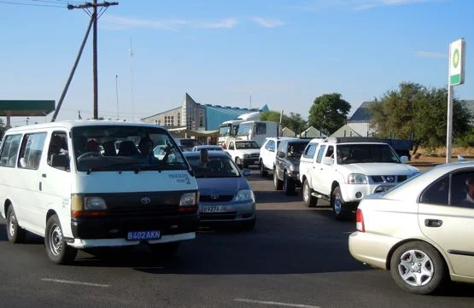
3
INTRODUCTION
Urban traffic congestion and road safety remain significant challenges worldwide. Traditional traffic control systems, from manual operation to early automated actuator-based systems, struggled to efficiently manage increasing vehicle volumes due to limitations like human error, rigid timing, and limited coordination.
Figure 1.0 : Traffic congestion in Botswana [1]
Modern traffic management increasingly rely on adaptive and coordinated control systems that use real-time traffic data, sensors, and computational techniques to optimize signal timings. Optimization methods, including evolutionary algorithms and predictive control strategies, have shown promise in improving traffic flow, reducing congestion, and enhancing urban mobility.

Slide 4
4
INTRODUCTION
Palapye lies on the A1 highway between Gaborone and Francistown.
Commercial and population growth have driven steady increases in traffic volume.
Signal controllers still run on static, fixed-time cycles.
Fixed cycles cannot adjust to changing demand during changing traffic demands.
This research develops an optimization-based signal control approach for the A1 corridor that run through Palapye.

Slide 5
6
PROBLEM STATEMENT
Urban intersections in Palapye experience increased traffic congestion, delays, and inefficient traffic flow due to conventional fixed-time traffic light control systems that do not adapt to real-time traffic conditions

Slide 6
7
OBJECTIVES
To design and implement an optimized traffic light control system that minimizes vehicle delays, reduces congestion, and improves traffic flow efficiency at urban intersections.
Design and implement adaptive signal timing algorithms that respond to real-time traffic conditions.
Implement coordinated control across multiple intersections to reduce stop-and-go traffic.
Quantitatively evaluate the MAPPO controller against a single-agent PPO baseline and a conventional fixed time controller across key traffic performance metrics.

Slide 7
5
LITERATURE REVIEW
Author and Publication Year | Title of study | Findings | Gaps In The Findings
Mansouryar et al., 2025 | Deep Reinforcement Learning for Traffic Light Control and Transit Priority | DRL outperforms fixed-time control on simulated corridors; agents adapt signal timing without explicit traffic models | Single-agent only , no coordination across adjacent junctions; corridor-level multi-agent control not explored
Mannion, Duggan & Howley, 2020 | An Experimental Review of Reinforcement Learning Algorithms for Adaptive Traffic Signal Control | DQL outperforms fixed-time control at isolated intersections enable agents to handle continuous | Single-intersection only independent DQL agents destabilise each other no coordination mechanism exists across the corridor
Kalašová et al., 2022 | The Impact of Actuated Control on the Environment and Traffic Flow | Actuated control reduces fuel consumption and emissions compared to fixed-time by extending green phases when vehicles are detected | Responds only to vehicle presence cannot estimate queue lengths, predict demand,
Wang & Shao, 2025 | GA-optimised PID controller for adaptive signal control | GA-tuned PID improved traffic regulation efficiency by 17.3% over fixed-time control | Single-intersection scope GA tunes parameters offline
dos Santos Ximenes et al., 2024 | Vehicular Traffic Detection for Smart Traffic Lights Using OpenCV | Camera-based detection achieves ~90% validates low-cost sensing | Fails under lighting changes and occlusion

Slide 8
8
AIM
To investigate and develop an optimization-based traffic signal control strategy that improves urban traffic flow, reduces congestion, and enhances road safety in Palapye

Slide 9
10
METHODOLOGY
MAPPO Multi-Agent Controller
Traditional single-agent RL controllers optimise one junction in isolation
MAPPO extends PPO to cooperative multi-agent settings each junction gets its own agent, but all three are trained together under a shared objective
Built on the Centralised Training, Decentralised Execution (CTDE) principle agents have access to global information during training but act purely on local observations at runtime.

Slide 10
9
METHODOLOGY
Theoretical Design
Two-phase approach : Phase 1 (single junction PPO baseline) → Phase 2 (full A1 corridor MAPPO)
SUMO micro-simulator + Python + TraCI as the core platform
Assumptions
No historical traffic data exists for Palapye A1 where all demand is synthetically parameterised from typical urban arterial volumes.
Pedestrian flows and movements are not modelled.
All vehicles treated with equal priority.

Slide 11
9
METHODOLOGY
Tools & Technologies
Category | Tool / Library
Sim-Agent Interface | TraCI (Traffic Control Interface)
Programming Language | Python ,XLM
RL Framework | Stable-Baselines3
Multi-Agent Environment | PettingZoo (Parallel API)
Deep Learning | PyTorch
Vehicle Detection | YOLOv8 (Ultralytics)
Computer Vision | OpenCV
Data & Visualization | NumPy, Pandas, Matplotlib

Slide 12
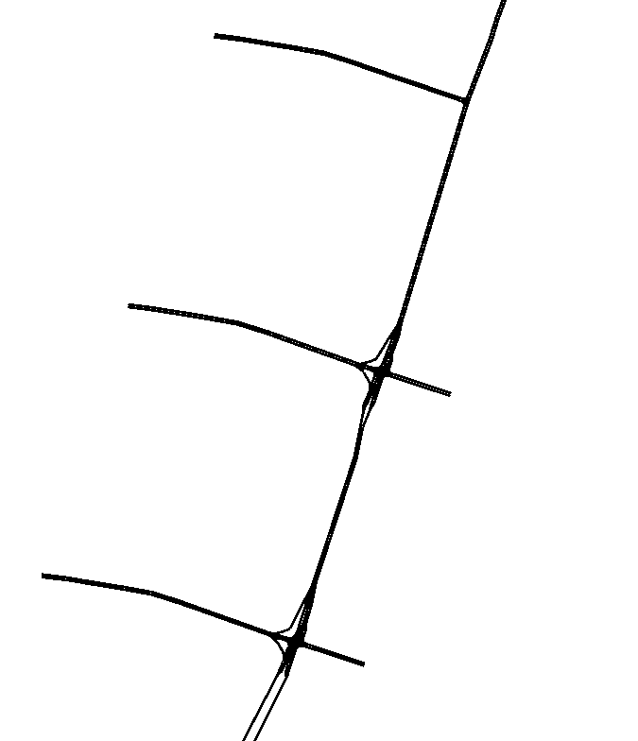
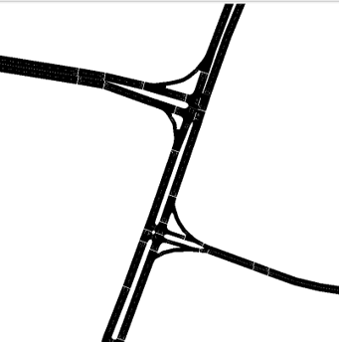
9
METHODOLOGY
Figure 2.0: Image of a single intersection
Figure 3.0: Image of multi-intersection

Slide 13
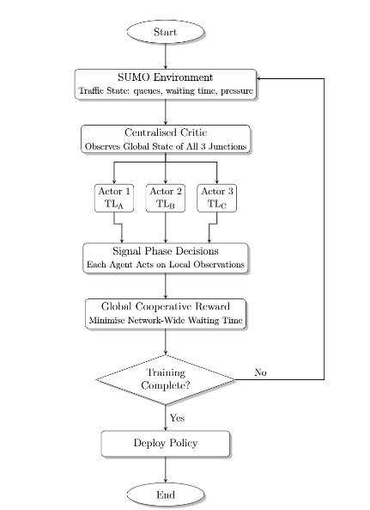
10
METHODOLOGY
Figure 4: MAPPO controller flowchart with Centralised Training, Decentralised Execution

Slide 14
10
METHODOLOGY
AGENT DESIGN
Observations
Queue length per lane
Vehicle arrival rate per approach
Current active signal phase
Average approach speed per lane
Actions
Action 0 — Phase A green (North-South through)
Action 1 — Phase B green (East-West through)
Action 2 — Phase C green (Protected/Secondary)
Rewards
+ Throughput
− Queue penalty
− Halting penalty — penalises stationary vehicles

Slide 15
10
METHODOLOGY
TRAINING SETUP
Training algorithm = MAPPO with parameter sharing
Number of agents = 3
Training timesteps = 1 500 00 steps
Curriculum training = 3 stages across 6 demand scenarios
Reward = global cooperative.
Framework = PettingZoo.
Environment = SUMO via TraCI.

Slide 16
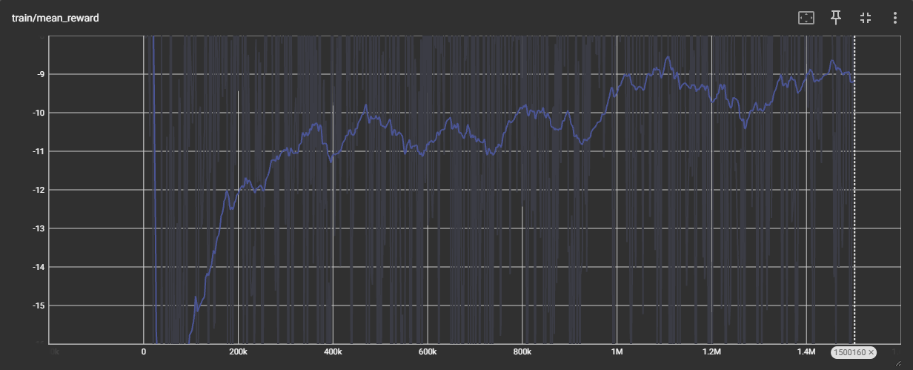
10
RESULTS AND ANALYSIS
TRAINING EVALUATION
Figure 5 : Mean reward graph of MAPPO during training
agents acting randomly with no coordination
Steep climb from 0 to 200k where agents are learning basic queue-clearing at each junction

Slide 17
10
RESULTS AND ANALYSIS
Performance Metrics
Waiting time
Queue length
Throughput
Pressure
Stop ratio

Slide 18
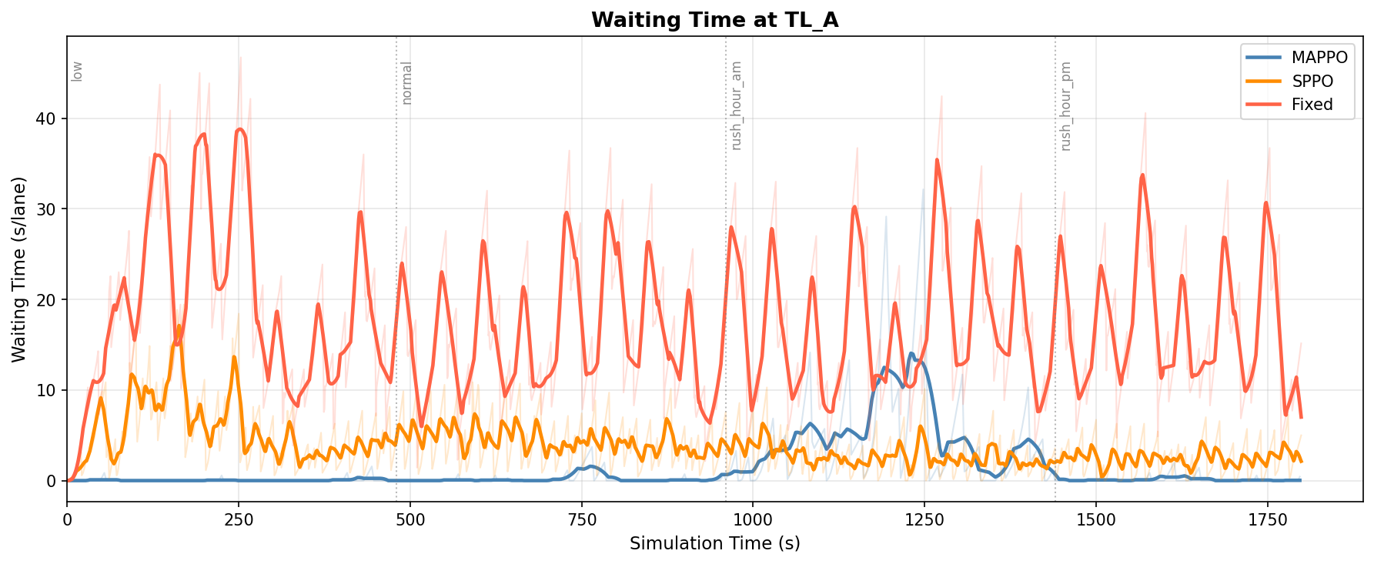
10
RESULTS AND ANALYSIS
Figure 6 : Graph showing Waiting time at TL_A

Slide 19
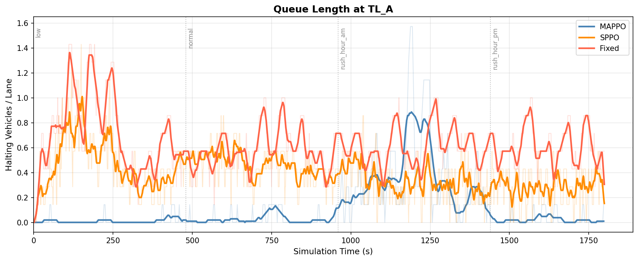
10
RESULTS AND ANALYSIS
Figure 7 : Graph showing Queue Length at TL_A

Slide 20
10
RESULTS AND ANALYSIS
Figure 6 : Graph showing Waiting time at TL_A

Slide 21
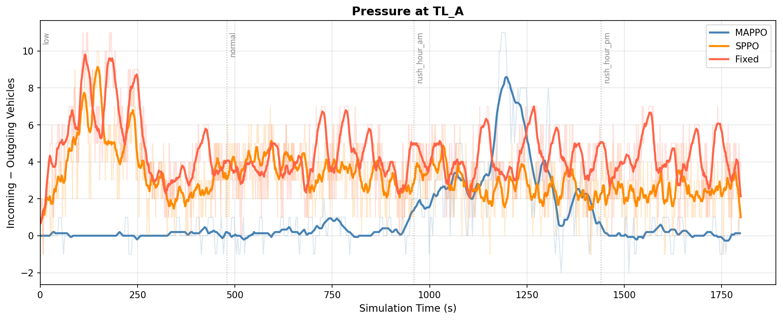
10
RESULTS AND ANALYSIS
Figure 7: Graph showing Throughput at TL_A

Slide 22
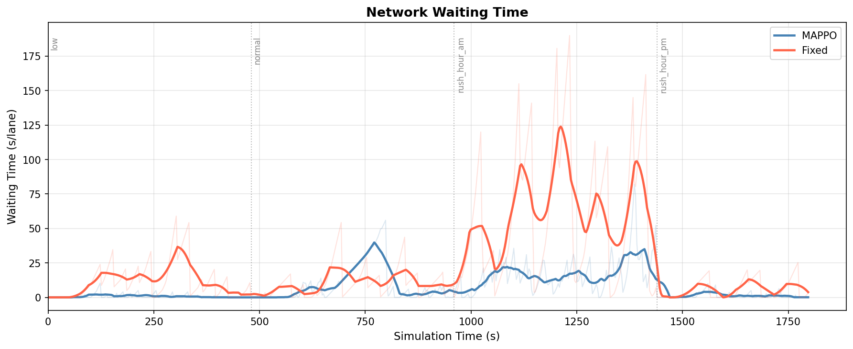
10
RESULTS AND ANALYSIS
Figure 8: Graph showing Waiting time , MAPPO vs Fixed-Cycle

Slide 23
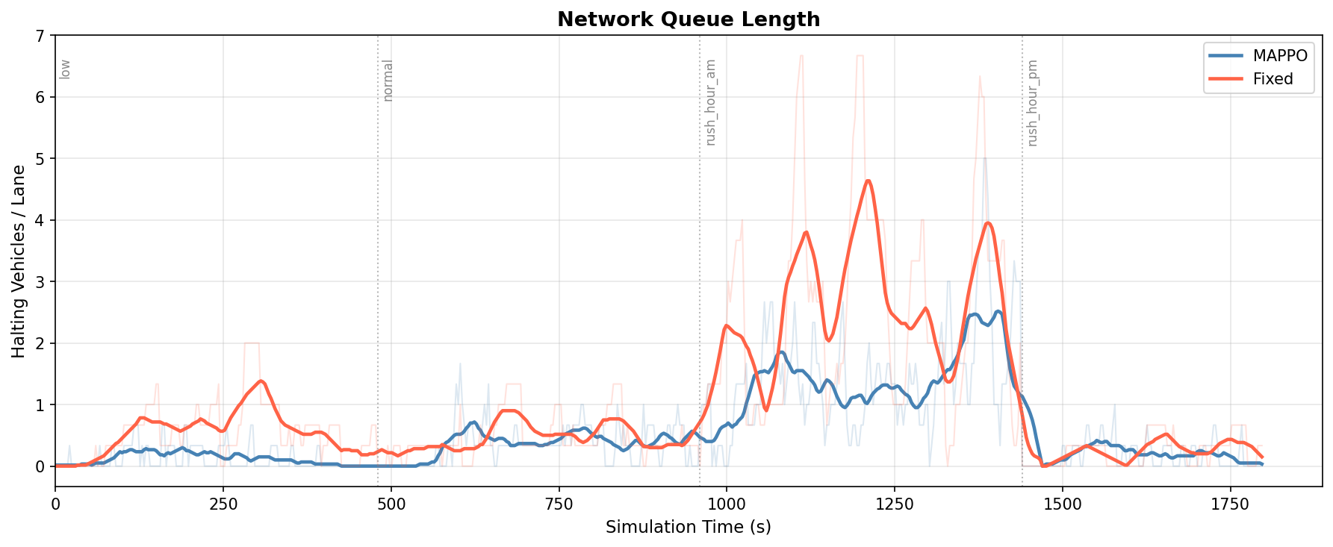
10
RESULTS AND ANALYSIS
Figure 9: Graph showing Queue Length, MAPPO vs Fixed-Cycle

Slide 24
12
CONCLUSION
Palapye's A1 corridor runs on fixed pre-timed signals that cannot respond to real-time demand
A MAPPO controller with CTDE architecture was designed and trained on a SUMO simulation of the A1 geometry.
MAPPO reduced network-wide waiting time by over 3x during peak demand compared to fixed-time control
YOLOv8 vehicle detection validated on real footage as a future deployment pathway
One of the quantitative benchmark for adaptive vs fixed-time control on a Botswana road network.

Slide 25
12
REFERENCES
[1] P. Bothoko, "Heavy traffic eases along A1 road," Mmegi Online, 2024. [Online]. Available: https://www.mmegi.bw
[2] C. Yu, A. Velu, E. Vinitsky, J. Gao, Y. Wang, A. Bayen, and Y. Wu, "The surprising effectiveness of PPO in cooperative multi-agent games," Advances in Neural Information Processing Systems, vol. 35, pp. 24611–24624, 2022.
[3] P. Michailidis, I. Michailidis, C. R. Lazaridis, and E. Kosmatopoulos, "Traffic signal control via reinforcement learning: A review on applications and innovations," Infrastructures, vol. 10, no. 5, p. 114, 2025.
[4] S. Mansouryar, C. Colombaroni, N. Isaenko, and G. Fusco, "Deep reinforcement learning approach for traffic light control and transit priority," Future Transportation, vol. 5, no. 4, p. 137, 2025.
[5] X. Wang and W. Shao, "Networked sensor-based adaptive traffic signal control for dynamic flow optimization," Sensors, vol. 25, no. 11, p. 3501, 2025.

Slide 26
12
CONCLUSION
THANK YOU FOR YOUR TIME
QnA

